Slide 1
A Balanced Diet
LEARNING REVIEW
Name the reagent that tests for lipids.
What colour does iodine solution turn in the presence of starch?
Which elements are found in proteins?
Name the monomer units of carbohydrates, fats and proteins?

Slide 2
Learning outcomes
2.24 Understand that a balanced diet should include appropriate proportions of carbohydrate, protein, lipid, vitamins, minerals, water and dietary fibre
2.25 Identify the sources and describe the functions of carbohydrate, protein, lipid (fats and oils), vitamins A, C and D, the mineral ions calcium and iron, water and dietary fibre as components of the diet
2.26 Understand how energy requirements vary with activity levels, age and pregnancy

Slide 3
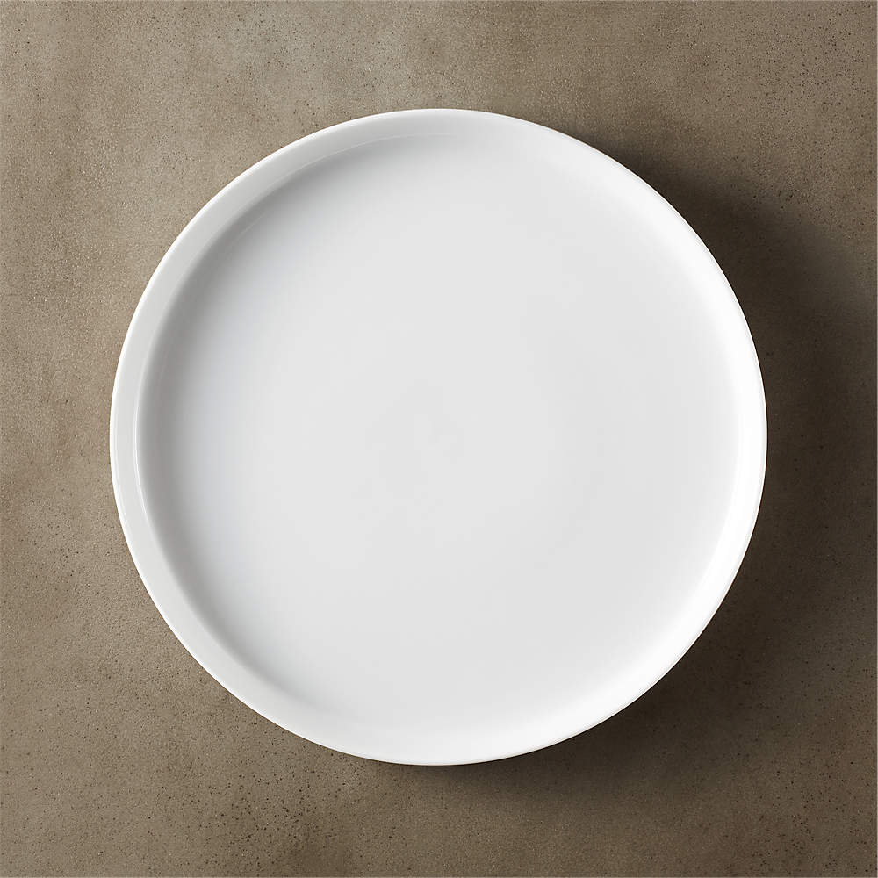
What should be included in a balanced diet?

Slide 4
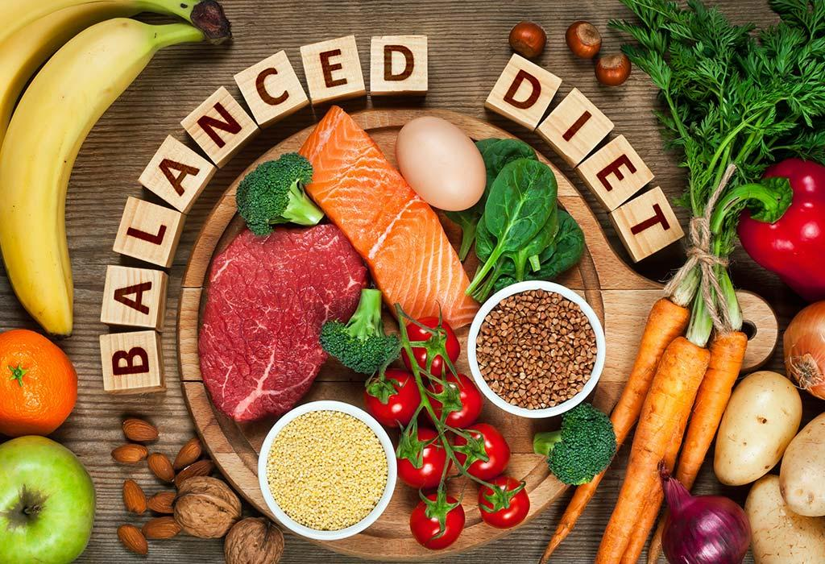
What are the sources and functions of the key nutrients?
Read the information in your booklet
Summarise the information in worksheet 2d Sources and Functions of Nutrients

Slide 5
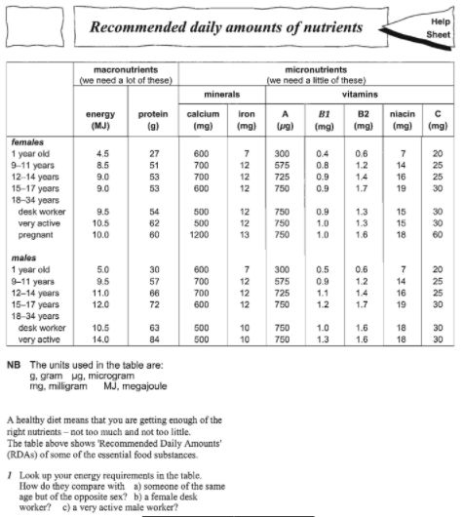
How much should we eat?

Slide 6
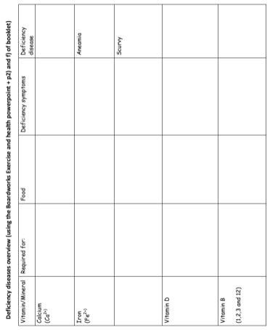
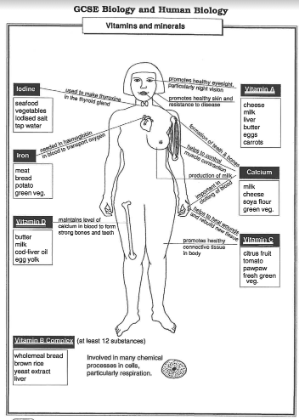
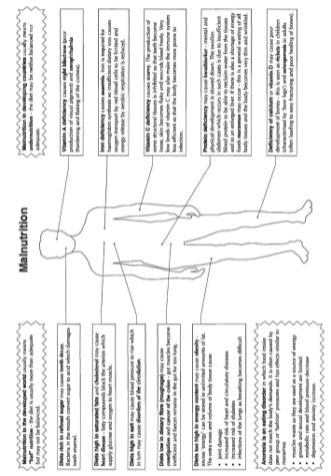
Malnutrition
Use the information from 2e and 2g to fill in deficiency diseases overview table.

Slide 7
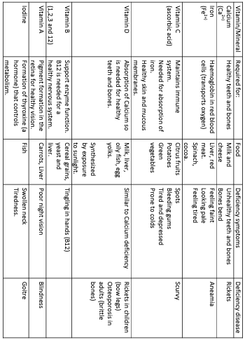

Slide 8
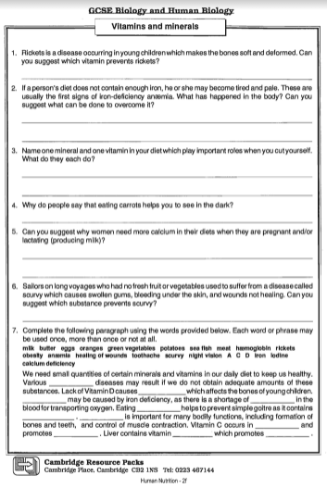
Vitamins and Minerals Page 2f

Slide 9
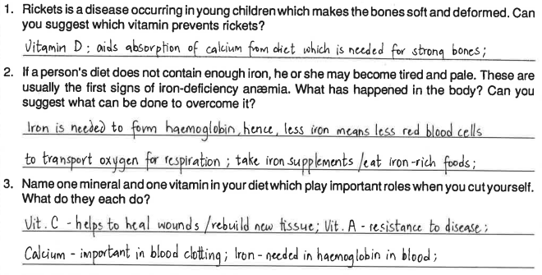
Answers

Slide 10
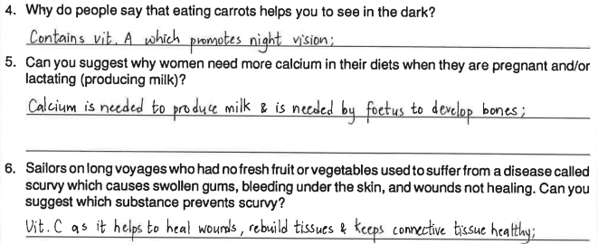
Answers

Slide 11
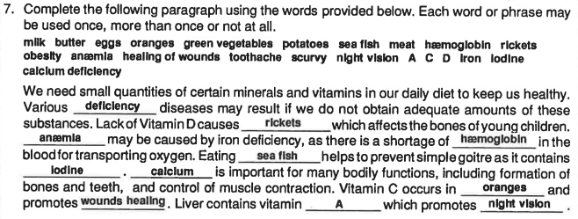
Answers

Slide 12
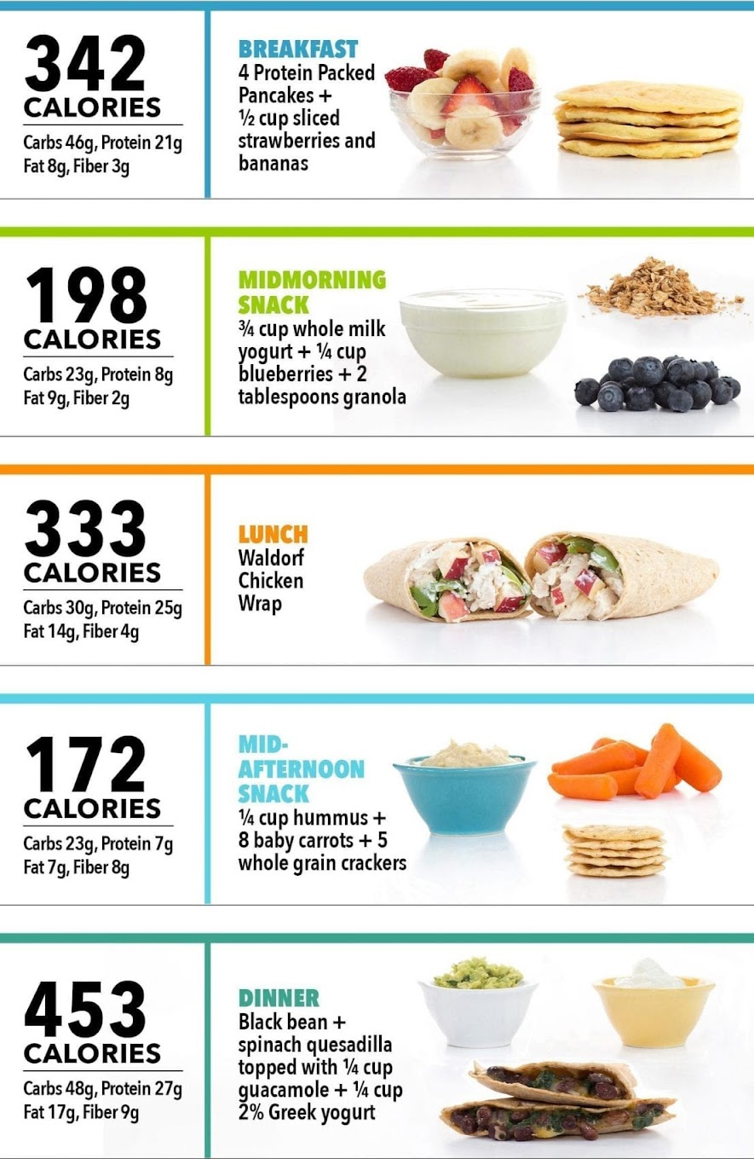
Create your own meal plan
Make a full day meal plan for yourself, or someone else.
Make note of the nutrient amounts in each food
Ensure they have got their recommended daily allowance of all nutrients by the end of the day!

Slide 13
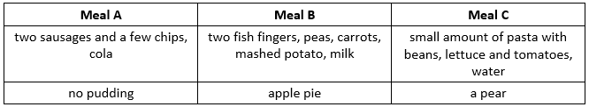
What’s on the menu?
Which meal would be best for an active, growing teenager? Explain your answer.
Which meal would be best for someone who wants to lose some body mass? Explain your answer.
People often say that they are going on a diet. What does the word ‘diet’ really mean?
Should a distance runner in training frequently eat meal C? Explain your answer.
An office worker whose only exercise is a five minute slow walk to the bus stop each day is constantly eating meals like meal B. What problem might they have? Explain your answer.

Slide 14
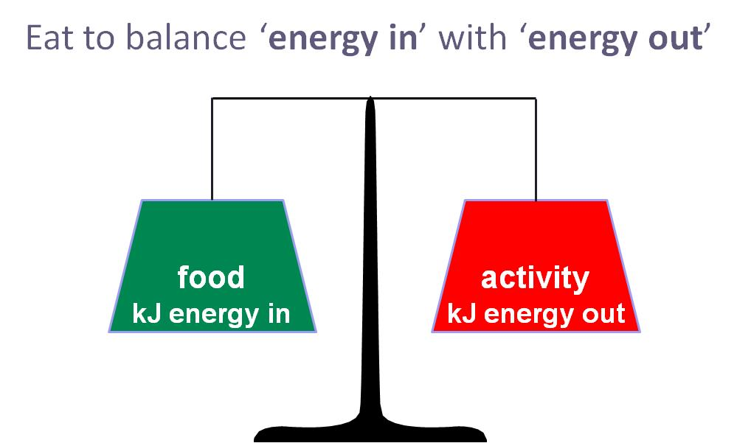
Energy In vs Energy Out
The amount of energy you use should be matched by the energy you take in from your food.
If you take in too much energy, you store it as fat so gain body mass.
If you take in too little energy, you use up fat stores for energy so you lose body mass.

Slide 15
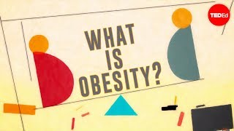
Obesity
Notes:
https://www.youtube.com/watch?v=-vNVG7XJpVE

Slide 16

Anorexia
Notes:
https://www.youtube.com/watch?v=jgjzUxosZ9o

Slide 17
Calculate your own energy intake
Step 1: Calculate your resting metabolic rate
For men:
RMR (in kcal/day) = 66.5 + (13.75 x weight in kilograms) + (5 x height in centimeters) – (6.76 x age in years)
For women:
RMR (in kcal/day) = 665 + (9.56 x weight in kilograms) + (1.85 x height in centimeters) – (4.68 x age in years)

Slide 18
Calculate your own energy intake
Step 2: Decide how active you are from the below list and then use it as a multiplier of your RMR from Step 1.
Lifestyle Activity Example Physical
Sedentary Little or no exercise 1.4 – 1.69
Moderately Active 1 hour exercise / day 1.7 – 1.99
Vigorously Active 2 hours exercise / day 2 – 2.4
Extremely Active Competitive athlete > 2.4

